Slide 1
Insurance Premium Default Propensity
Capstone Project
Kudakwashe Nyikadzino

Slide 2
Contents
Executive Summary
Typical Customer
Defaulting Customers
Default, Income and Cash Premiums
Analytical Approach
Model Evaluation and Results
Final Model Selection
Insights
Recommendations
Final Word

Slide 3
Executive summary
The Problem
The impact of insurance premium defaults on revenues.
The Approach
Build a machine learning model to identify defaulting customers.
The Outcome
Provide insights and recommendations on reducing defaults.

Slide 4

Who is the typical customer
Sourcing Channel - A
Age - 51
Cash Premiums % - 32
Residence - Urban
Premiums Paid - 11
Risk Score – 99,07

Slide 5
Defaulting customers
Highest Default
Unmarried, Renting, Urban, Channel E
Lowest Default
Married, Own Property, Urban, Channel E

Slide 6
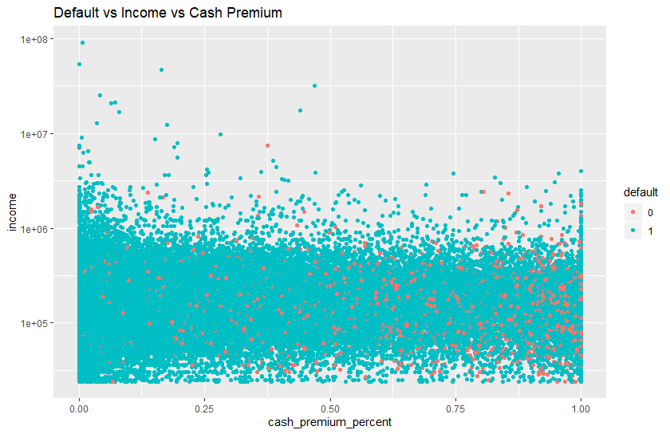
Default, Income and Cash Premiums

Slide 7

Analytical approach
Machine Learning
Raw data
Supervised Learning
Processing
Models
Classification
Algorithms
KNN
Naïve Bayes
Logistic Regression
Bagging
Boosting
Final Model

Slide 8
Model Evaluation and Results
Accuracy, Sensitivity and AUC as performance measures

Slide 9
Final Model Selection
Why Logistic Regression
Sensitivity
Interpretation
Maintenance

Slide 10
Insights
Percentage of premium paid as cash the most important variable
Not all variable are important – e.g. residential area type
Accuracy alone is not the only basis to select the model
Positive relationship between default and the number of late payments

Slide 11
recommendations
Promote use of non-cash payment methods for premiums
Use percentage of premiums as a qualifier for providing insurance
Develop a communication system that notifies customers when premiums are due
Focus marketing efforts on sourcing channels with lower default rates
Remove unnecessary information in the application process

Slide 12
Final Word
There will be missed opportunities based on the model in use
Consider other variables like employment type e.g. part-time or full-time
Ensure accurate data is captured and continuous model improvement

